Slide 1
Working Seamlessly with the R-ArcGIS Bridge
TUgis: Maryland’s Geospatial Conference
August 8, 2018
Jonathan Gross, MPH, CPH
Epidemiologist
Baltimore City Health Department
Office of Youth Violence Prevention
jonathan.gross@baltimorecity.gov
Phone: 443-984-3564

Slide 2
Overview
Introduction to the R-ArcGIS Bridge
Installation tips
Import a real-world point feature class from a geodatabase into R
Use it in R to learn about the dataset
Intro to R's mapping and spatial analysis

Slide 3
Presenter Disclosure
Jonathan Gross has no personal financial relationships with commercial interests relevant to this presentation.
The content of this presentation was generated by Mr. Gross in his personal capacity. The views expressed in this session are his own and do not necessarily represent those of the Baltimore City Health Department or the City of Baltimore.

Slide 4
Materials
GitHub: https://github.com/bchd/epi/tree/R-ArcGIS-Bridge
One ZIP file containing:
Geodatabase with data from Open Baltimore (https://data.baltimorecity.gov)
Point feature classes for crime victims
Projected (Maryland State Plane, feet)
Geographic Coordinate data (WGS 84)
Neighborhood boundary file with 2010 census data
R Script

Slide 5


Free Software You Will Need
(3.1+): https://www.r-project.org/
Free and open-source statistical program
12,000+ packages/libraries
Can run into issues with packages and R versions
Focus is data analysis
*32-bit*
: https://www.rstudio.com/
IDE = Integrated Development Environment
View your data, graphs, etc.
Detect and fix errors
Help pages
Source, ESRI: https://github.com/R-ArcGIS/r-bridge-install.

Slide 6
Paid Software You Will Need
ArcGIS Desktop (10.3.1+): 32/64-bit
OR: ArcGIS Pro (1.1+): 64 bit
Use background geoprocessing option with ArcGIS Desktop 64-bit (extra download)
R-ArcGIS Bridge (Toolbox):
https://github.com/R-ArcGIS/r-bridge-install
Bridge is free

Slide 7
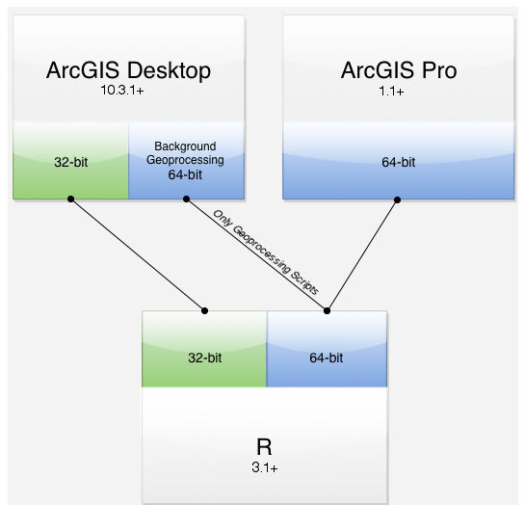
Installation Options
Source: ESRI. https://github.com/R-ArcGIS/r-bridge-install.

Slide 8
Why Link R and ArcGIS?
Prior R classwork in grad school (2005-6)
Streamlining public health surveillance of non-fatal overdoses.
Space-time cluster analysis.
R can call SaTScan (https://www.satscan.org/).
Reduce work-burden/time/costs in long-term
ArcGIS lacks tools found in statistical packages (has a different focus).
Automate analysis and reporting using Python and R.

Slide 9
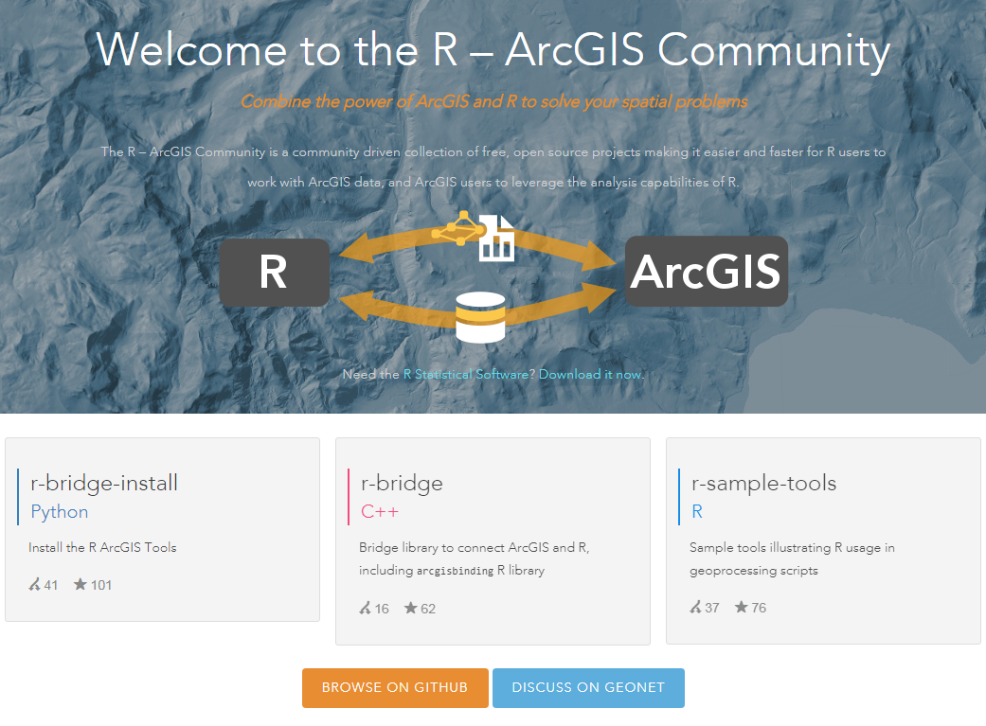
R-ArcGIS Bridge Main Page
https://r-arcgis.github.io/
Add this toolbox

Slide 10
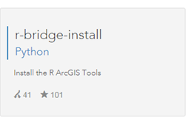
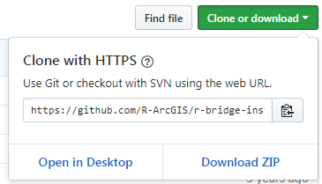

Installing the Bridge
https://github.com/R-ArcGIS/r-bridge-install
On the right-hand side, you’ll see a green button for downloading the R-ArcGIS Bridge
You’ll unzip this and then
add the R Integration
Python toolbox in ArcGIS
- Right-click in the
Toolbox window.

Slide 11
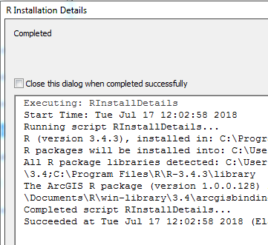
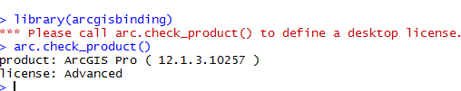
Checking Installation
Two ways:
In ArcGIS:
In R:
arcgisbinding package/library
arc.check_product()

Slide 12
R Code

Slide 13

Installing Packages
install.packages("arcgisbinding")
library(arcgisbinding)
arc.check_product()
Most packages are in repositories (CRAN, etc. and can be installed using: install.packages(“packagename”)

Slide 14
Sample Data
ZIP file: https://github.com/bchd/epi/tree/R-ArcGIS-Bridge
Part I Victim-based Crime Data from Open Baltimore (https://data.baltimorecity.gov/)
Homicide victims (all weapons) and non-fatal shooting victims
Time period: January 2012 - Summer 2018
Some records have missing/null geography
Can be accessed at: https://data.baltimorecity.gov/Public-Safety/BPD-Part-1-Victim-Based-Crime-Data/wsfq-mvij/data.

Slide 15
Import – Method 1: Using arcgisbinding library
# Set YOUR Working Directory. Use Forward Slashes / or //.
setwd(‘PUT YOUR WORKING DIRECTORY HERE')
# Method 1 use arcgisbinding library to Import Data:
# Imports a feature class of open crime data.
input<-file.path(getwd(),'OpenCrimeData.gdb','PartICrime_Projected')
open_crime<-arc.open(input)
# Creates a tabular dataframe (r_open_crime) and converts Spatial Data to Sp Objects (spatial_open_crime).
r_open_crime<-arc.select(open_crime)
spatial_open_crime<-arc.data2sp(r_open_crime)

Slide 16
Import – Method 2: rgdal library
library(sp)
library(rgdal)
library(sf)
geodata <- ‘YOUR WORKING DIRECTORY HERE/OpenCrimeData.gdb'
subset(ogrDrivers(), grepl("GDB“, name))
# Reads OGR vector into Spatial objects
fc_list <- ogrListLayers(geodata)
print(fc_list)
# Read the feature class
spatial_r_data<- readOGR(dsn=geodata,layer="PartICrime_Projected")
tabular_r_data<- st_read(dsn=“/OpenCrimeData.gdb","PartICrime_Projected")
OpenGIS Simple Features Reference = (OGR) for Vector-data
Note: Method #2 imports missing/null geographies. Also does better job with date/time fields.

Slide 17
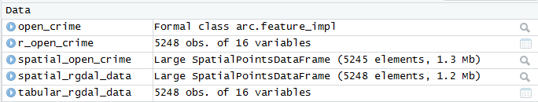
Sample Sizes from Import Methods
Recently, I asked this question about nulls not being imported on ESRI GeoNet: https://community.esri.com/message/788424-the-r-arcgis-bridge-does-not-import-data-into-r-with-null-geography

Slide 18
R: Examples of Types of Datasets
What you can do in R is defined by datatypes
Dataframe
Matrix
arc.data, arc.shape,…
SpatialPointsDataFrame (Point shapefile in ArcGIS)
If you are unable to run a function or package, you may have the wrong data type!

Slide 19
R: Types of Datasets
Function | Use
arc.open(path) | Loading ArcGIS datasets, tables, and layers into an R Workspace
arc.select(object,fields, where_clause,selected,spatial_reference) | Loading a subset of the dataset into an R dataframe
arc.shape(dataframe) | The shape object is required for analysis
arc.shape2sp(dataframe) | Converting from an arc.shape_class to a sp object
arc.sp2data(sp dataframe) | Converting from an sp data frame object to an arc.dataframe object
arc.data2sp(dataframe) | Converting from an arc.data frame object to an sp dataframe object
arc.shapeinfo(arc.shape(dataframe)) | Access Geometry information stored
arc.write(path,data,cords=NULL,shape_ info=NULL | Exporting a dataframe object to an ArcGIS dataset.
Source: ESRI Training, Using the R-ArcGIS Bridge: https://www.esri.com/training/catalog/58b5e417b89b7e000d8bfe45/using-the-r-arcgis-bridge/.

Slide 20
Calling Variables within R
If you are working with one dataset you can use attach() function
Typically, you will work with multiple datasets
Dataset$variablename
Better to do in practice, since two or more datasets can have the same variable names.

Slide 21
Date Formats
R (or the ArcGIS-Bridge) does not always import dates correctly.
A simple fix can be applied:
r_open_crime$CrimeDate <-
as.Date(r_open_crime$CrimeDate,format ='%m/%d/%Y' )

Slide 22
Essential R/Data Operations
Cleaning data, knowing source, limitations,…
Working with dates
Subsetting data
Aggregate and transform data
Merging different datasets
Spatial and time series analysis, and other visualizations

Slide 23
Q: So, what can you do in R?
A: Pretty much everything!
Data science, visualizations, and even spatial statistics.

Slide 24
Visualization Example: Treemap
install.packages("treemap”)
install.packages("RColorBrewer")
library(treemap)
library(RColorBrewer)

Slide 25
Visualization Example: Treemap
colnames(crime_sum)<-c("Neighborhood","Total_Incidents")
treemap(crime_sum,index=c("Neighborhood"),
vSize=c("Total_Incidents"),
palette="Reds",
vColor="Total_Incidents",
fontsize.labels = 8,
title="Baltimore City: Number of Homicide Victims by Neighborhood, January 2012 – Summer 2018",
mapping=c(0,10,50),type="value”,force.print.labels = TRUE)

Slide 26
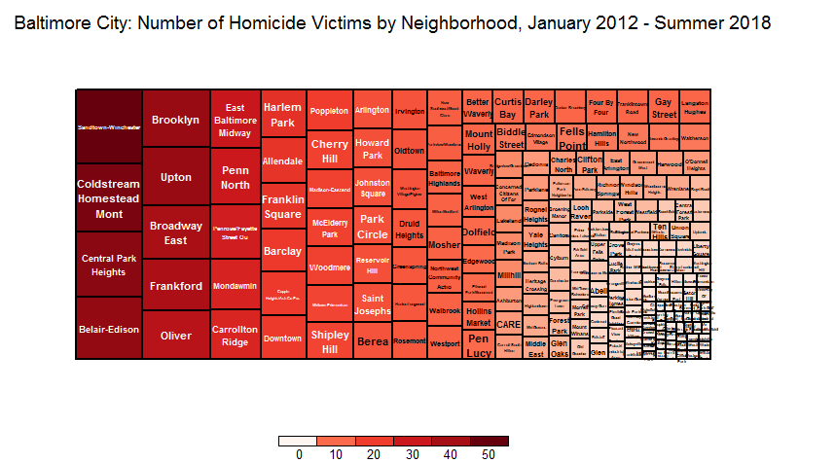
Result
Roughly half of the total number of homicides are confined to a relatively small number of neighborhoods.

Slide 27
Also, check out heatmaps, which classify and symbolize cell values in tables. This is particularly useful for space-time data.

Slide 28
R Mapping Intro
Why Map in R?
Perform non-spatial and spatial analysis
Has spatial statistics and advanced options that may not be found in ArcGIS
You want to automate something and be more familiar with R
vs. Python or ModelBuilder
Or, use Shiny Apps, R Markdown, for dashboards, etc.

Slide 29
R Mapping Example
At a mapping conference!
Won’t go through basic mapping.
We’ll look at practical example, which is complex, but solved in a few lines of code!

Slide 30
R Mapping Example
We want to create a density map for homicides for each month in a year.
Uses GISTools package
I expanded it and added a loop:
Only ~10 lines of code
Projection warning because of how R package is implemented. Other density implementations will be easier to re-project.

Slide 31
R Mapping Example
# New graphics frame
plot.new()
# Set graphical parameters. Map sequence in 3 rows, 4 columns
par(mfrow=c(3,4),mai=c(0.5,0.5,0.5,0.5))
# Create loop and add kernel density
for (month in c("01","02","03","04","05","06","07","08","09","10","11","12")){
density<-
kde.points(spatial_open_crime[spatial_open_crime$month==month,],lims=neighborhoods)
level.plot(density)
masker<-poly.outer(density,neighborhoods,extend=100)
add.masking(masker)
plot(spatial_open_crime[spatial_open_crime$month==month,],pch=20,cex=1.5,add=TRUE)
title(main=month,outer=F)
}
# Places title around border with map series in the middle.
title(main="Baltimore City: Kernel Density for Homicides by Month, 2017",outer=T,line=-1)

Slide 32
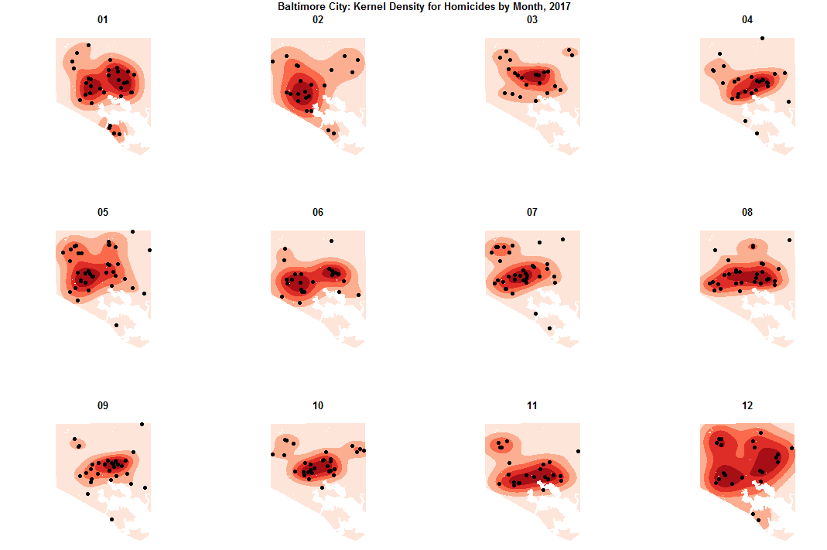

Slide 33
Helpful GIS-related Packages
Package | What it does | Link to PDF
GISTools | Mapping and spatial analysis | https://cran.r-project.org/web/packages/GISTools/GISTools.pdf
sp | Classes and methods for spatial data | https://cran.r-project.org/web/packages/sp/sp.pdf
maptools | Reading and handling spatial objects | https://cran.r-project.org/web/packages/maptools/maptools.pdf
rgdal | Bindings for Geospatial data | https://cran.r-project.org/web/packages/rgdal/rgdal.pdf
spatstat | Point Pattern Analysis | https://cran.r-project.org/web/packages/spatstat/spatstat.pdf
spatialEco | Spatial Analysis and Modelling | https://cran.r-project.org/web/packages/spatialEco/spatialEco.pdf
spdep | Spatial weights, LISAs, Morans I, etc. | https://cran.r-project.org/web/packages/spdep/spdep.pdf
SpatialEpi | Methods for Spatial Epidemiology | https://cran.r-project.org/web/packages/SpatialEpi/SpatialEpi.pdf
Just a few, maps, raster…Not a complete list!

Slide 34
Helpful non-GIS Packages
Package | What it does | Link to PDF
forecast | Time-series analysis | https://cran.r-project.org/web/packages/forecast/forecast.pdf
ggplot2* | Data visualizations and mapping | https://cran.r-project.org/web/packages/ggplot2/ggplot2.pdf
gplots | Plotting data, create ‘heat map’ visualizations for tabular data | https://cran.r-project.org/web/packages/gplots/gplots.pdf
pylr | Tools for Splitting, applying, and combining data | https://cran.r-project.org/web/packages/plyr/plyr.pdf
RColorBrewer | ColorBrewer Palettes | https://cran.r-project.org/web/packages/RColorBrewer/RColorBrewer.pdf
Reshape2 (tidyr) | Reshape data | https://cran.r-project.org/web/packages/reshape2/reshape2.pdf
summarytools | Summarize data | https://cran.r-project.org/web/packages/summarytools/summarytools.pdf
stringr | Common string operations | https://cran.r-project.org/web/packages/stringr/stringr.pdf
treemap | Create treemap visualizations | https://cran.r-project.org/web/packages/treemap/treemap.pdf

Slide 35

Wait, there’s more!
Today, we talked about moving spatial data into R
We can also move data and R’s powerful statistical and spatial abilities back into ArcGIS!

Slide 36
We did not get to talk about…
Design tools in R and use them in ArcGIS
Incorporate into ModelBuilder and toolboxes
Shiny apps, etc.
R markdown, notebooks, dashboards

Slide 37
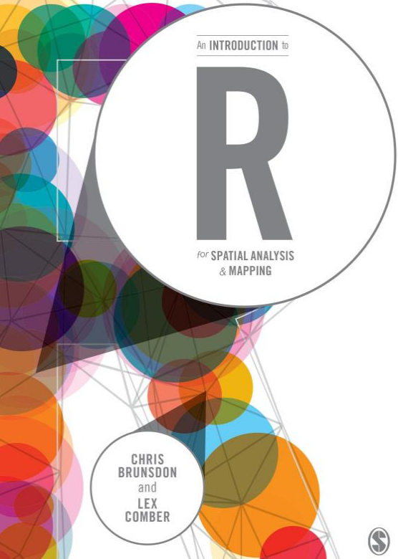
References
Bridge Main Page: https://r-arcgis.github.io/
ESRI Training (5 courses)
www.esri.com/training/Bookmark/FKYJSNTP5
Book: An Introduction to R for Spatial Analysis & Mapping by Brusdon and Comber (at right)->
GeoNet: https://community.esri.com/groups/rstats

Slide 38
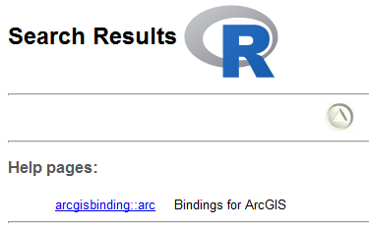
Getting R Help
Multiple ways to search
help(“plot”)
example(“plot”)
?arcgisbinding
R Studio Help Panel
See more examples at: https://www.r-project.org/help.html

Slide 39
Data Sources
Open Baltimore: https://data.baltimorecity.gov/
Part I victim-based crime data:
https://data.baltimorecity.gov/Public-Safety/BPD-Part-1-Victim-Based-Crime-Data/wsfq-mvij/data
Census data
https://data.baltimorecity.gov/Neighborhoods/2010-Census-Neighborhoods/r3qj-2ifh

Slide 40
Disclaimer: The accompanying code is for educational purposes and comes with no guarantees.
Contact Jonathan Gross
jonathan.gross@baltimorecity.gov
if you have any questions.

